Slide 1







Simulating Attacks and Writing a SOC Report for SoluTech
By Okoli Ugochukwu Benneth
18/07/2025

Slide 2

Contents
1. Executive Summary
2. Attack summary
3. Screenshot evidence alert of Wazuh
4. Timeline of detected events
5. Source of attacks (IP, methods used)
6. Recommendation of detecting or blocking attacks

Slide 3
Executive Summary
This project simulates cyberattacks for SoluTech, a mid-sized African technology firm facing growing cyber threats due to increased remote access and internet-facing applications. To bolster security, SoluTech established a SOC using Wazuh SIEM, pfSense for network segmentation, and security agents on Linux and Windows endpoints.
The project provides SOC Analysts with hands-on experience using tools like Kali Linux, Ubuntu, and Windows 10 to detect and investigate suspicious activities such as failed logins and brute-force attacks. Analysts develop skills in threat detection, incident analysis, and SOC reporting, improving their ability to respond effectively.
Deliverables include detailed incident reports and technical evidence. This controlled environment strengthens SoluTech’s cybersecurity posture by reinforcing defense-in-depth strategies and preparing Analysts for real-world security operations.

Slide 4
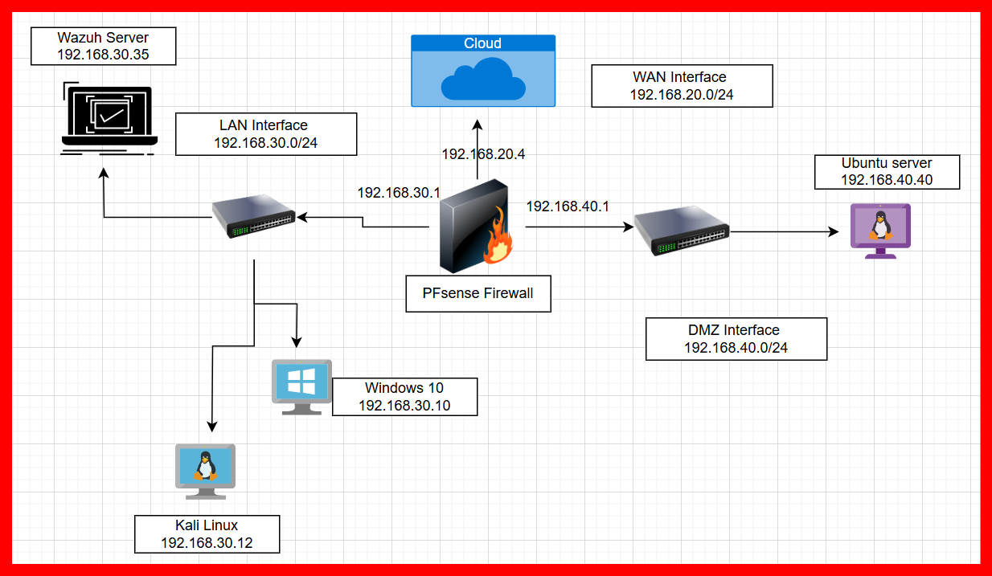
Attack Summary:
Soc Analysis Network Design:
This SOC analysis network design illustrates the WAN, LAN, and DMZ interfaces along with their associated IP addresses within the network environment. It also includes the Ubuntu and Windows 10 system; each displayed with their respective IP addresses.

Slide 5
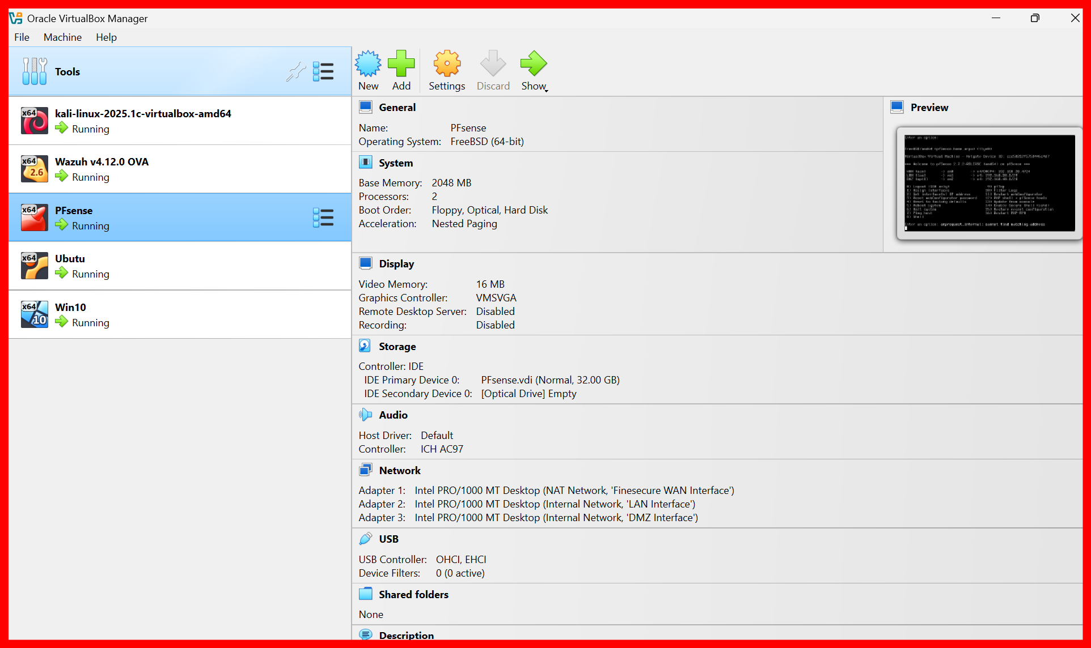
Attack Summary:
VM and Network setup
The diagram above illustrates the virtual machine and network configuration involving WAN, LAN, and DMZ segments managed by pfSense, which functions as the network firewall. Key components include:
• pfSense: Acts as the firewall controlling traffic across different network zones.
• Wazuh: Deployed as the Security Information and Event Management (SIEM) system.
• Ubuntu: Configured as a server within the network.
• Kali: Simulates an attacker machine for security testing purposes.
• Windows 10: Included as a client system on the LAN.

Slide 6
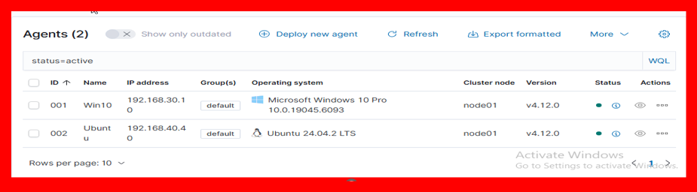
Attack Summary:
Ubuntu and Win 10 Agents Installation
The diagram details the Wazuh agent deployment, showcasing the ID, Name, IP Address, Group, Operating System, Cluster Node, Version, Status, and Action for both the Ubuntu and Windows 10 agents. Their green status indicators confirm active operation.
The installation commands used for these agents are as follows:
• For Windows 10:
Invoke-WebRequest -Uri https://package.wazuh.com/4.x/windows/wazuh-agent-4.12.0-1.msi -OutFile $env:tmp\wazuh-agent; msiexec.exe /i $env:tmp\wazuh-agent /q WAZUH_MANAGER='192.168.30.35'
This command downloads the Wazuh agent MSI package and silently installs it, configuring the agent to connect to the Wazuh Manager at 192.168.30.35.
• For Ubuntu:
wget https://package.wazuh.com/4.x/apt/pool/main/w/wazuh-agent/wazuh-agent_4.12.0-1_am64.deb && sudo WAZUH_MANAGER='192.168.30.35' dpkg -i ./wazuh-agent_4.12.0-1_am64.deb
We also use the commands below to enable Apache and ssh service on ubuntu server.
▪ Sudo apt-get install apache2 -y
▪ Sudo apt-get install openssh_server -y

Slide 7
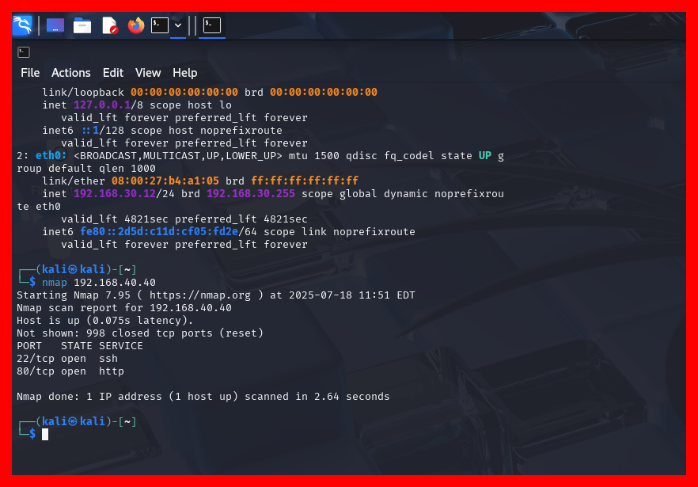
Attack Summary:
• Nmap Used to scan Open Ports.
The diagram shows the port state service for Open ssh and http. Using the Kali Linux command line, the Nmap tool was used to scan and identify vulnerabilities on the Ubuntu server with IP address 192.168.40.40. By running scans, Nmap detects open ports, running services, and the server’s operating system version. This helps the attacker to discover potential entry points and weaknesses on the target Ubuntu server, enabling further exploitation or testing. Nmap’s flexible commands allow for tailored scans to map the network, detect firewall settings, and reveal exposed services, forming a crucial first step in offensive security assessments or penetration testing.

Slide 8
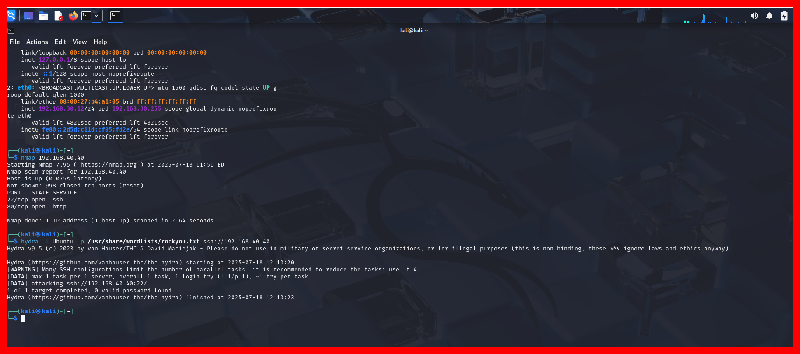
Attack Summary:
• Command used on Kali Linux to attack Ubuntu Server
This shows the Kali command line, the Hydra tool performs a brute-force attack on the Ubuntu server at IP 192.168.40.40 by targeting the SSH service. The specific command hydra -l Ubuntu -p /usr/share/wordlists/rockyou.txt ssh://192.168.40.40 attempts to log in as the user “Ubuntu” by systematically trying passwords from the “rockyou.txt” wordlist. This process tests for weak or common passwords to gain unauthorized access. Hydra’s high speed and parallelized approach make it effective for identifying vulnerable SSH credentials, demonstrating how attackers exploit weak authentication. This technique is widely used in penetration testing to assess server security and improve defenses against real brute-force attacks

Slide 9
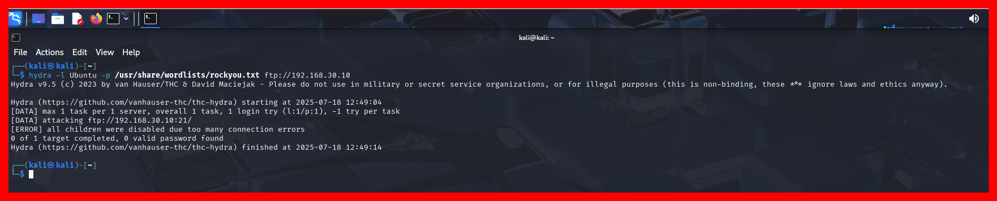
Attack Summary:
• Command used on Kali Linux to attack Win 10 client system.
Using the Kali command line, the Hydra tool launches a brute-force attack against the Windows 10 client system at IP address 192.168.30.10 by targeting its FTP service. The command hydra -l Ubuntu -p /usr/share/wordlists/rockyou.txt ftp://192.168.30.10 attempts to log in with the username "Ubuntu," trying passwords from the "rockyou.txt" wordlist. This method tests for weak or commonly used passwords to gain unauthorized FTP access. Such attacks help identify

Slide 10
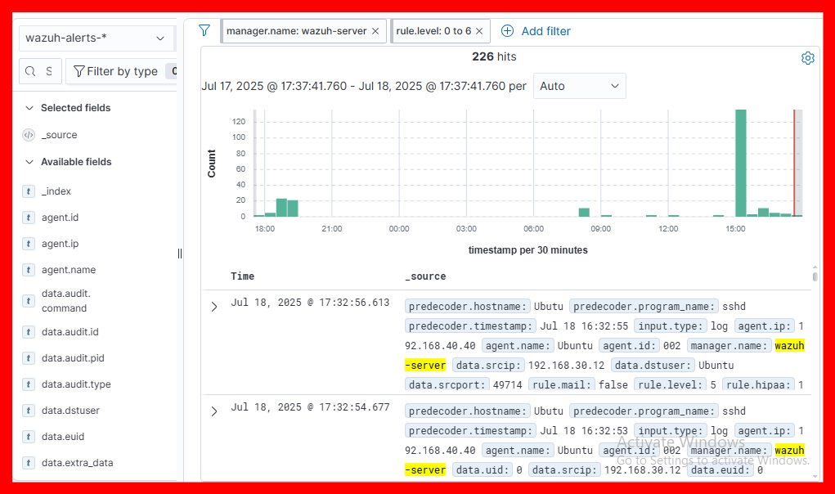
Screenshot evidence alert of Wazuh
• Wazuh SIEM.
The attached Wazuh SIEM screenshot confirms detection of a security event originating from IP 192.168.40.40—the Kali Linux attacker—targeting the Ubuntu server on July 18, 2025, at 16:32:55 via unauthorized SSH login attempts. This aligns with common SSH brute-force attack patterns described in security research and simulated attack scenarios using Hydra against SSH services. Wazuh’s real-time alerting effectively flagged repeated authentication failures, demonstrating its capability to monitor, detect, and log such intrusions promptly. These capabilities are critical for timely incident response, helping SOC teams identify and mitigate threats early, thereby maintaining system integrity and security across the network. This evidences Wazuh’s role as a robust SIEM solution in detecting and preventing brute-force attacks in diverse IT environments

Slide 11
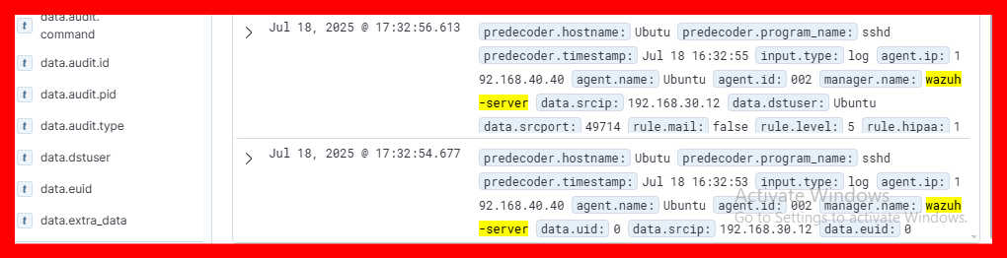
Timeline of detected events
• Time of attack.
The timeline indicates that unauthorized SSH login attempts from 192.168.40.40 against the Ubuntu server occurred consistently, starting at 16:32:55 and ending at 17:32:56 on July 18, 2025. Wazuh SIEM’s real-time monitoring captured these events, demonstrating effective alerting and logging capabilities. This evidence highlights risk from SSH brute-force attacks and the importance of continuous SIEM monitoring within SoluTech’s network environment.

Slide 12
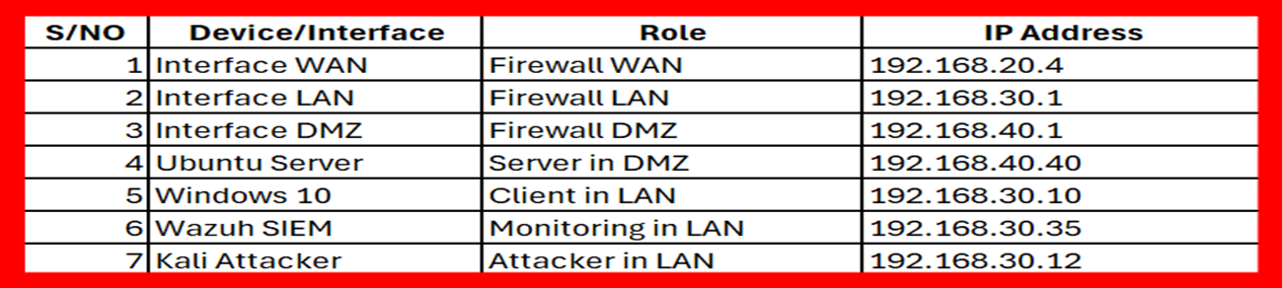
Source of attacks (IP, methods used)
• IP Address Configuration:
The source of the attack has been identified as the Kali Attacker device with IP address 192.168.30.12, operating within the LAN. The targeted system is the Ubuntu Server located in the DMZ with IP address 192.168.40.40. The attack method involved using penetration testing tools such as Hydra or Nmap to perform brute-force login attempts and network scanning on services like SSH or FTP running on the Ubuntu server. Specifically, Hydra is commonly used to automate brute-force attacks by trying multiple username and password combinations to gain unauthorized access. This form of attack tests the resilience of the server against unauthorized access and is frequently employed in authorized penetration testing to identify vulnerabilities and reinforce security measures.

Slide 13
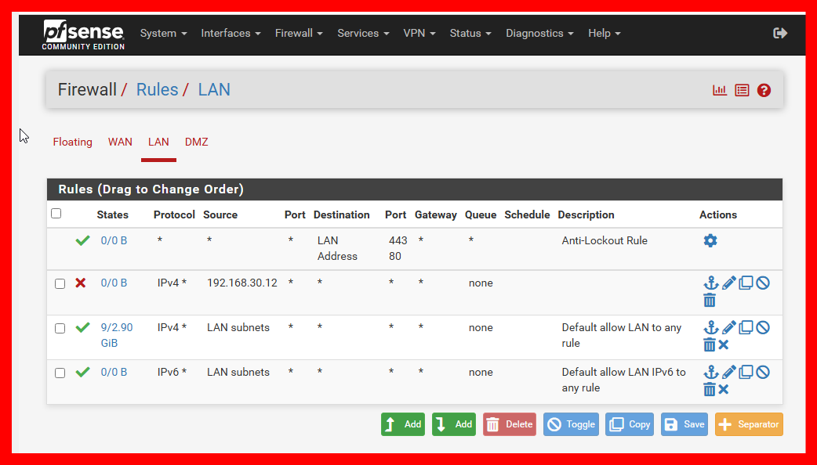
Recommendation of detecting or blocking attacks
• Blocking the Kali Linux IP 192.168.30.12
The IP address 192.168.30.12, identified as the Kali Linux attacker, was successfully blocked using the pfSense firewall to prevent further malicious activity. This was achieved by creating a firewall rule on the LAN interface configured to:
Action: Block; Interface: LAN; Source IP: 192.168.30.12 (single host); Protocol: Any; Destination: Any
Additionally, tools like pfBlockerNG can automate IP blocklist management, offering enhanced protection by continuously updating blacklists. Blocking this IP effectively isolates the attacker from internal network resources, strengthening network security and preserving system integrity. Continuous monitoring and rule updates are recommended to ensure ongoing defense against similar threats.

Slide 14
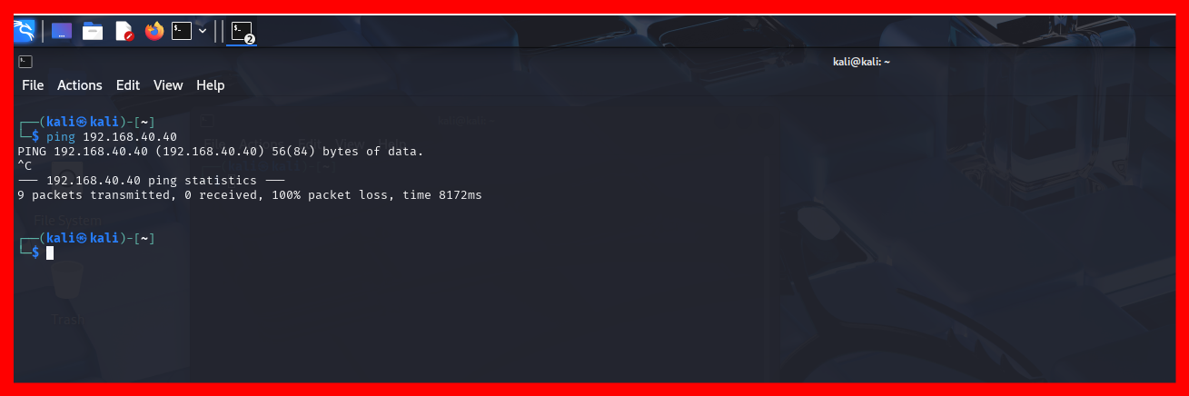
Recommendation of detecting or blocking attacks
• Blocking the Kali Linux IP 192.168.30.12
A firewall rule was configured on the LAN interface to block all traffic from the IP address 192.168.30.12, effectively preventing any further malicious activity from the attacker within the internal network. Following this, a ping test was conducted from the Kali Linux machine targeting the Ubuntu server at 192.168.40.40. The ping requests did not receive any response, confirming that the firewall block is successfully isolating the attacker’s IP and preventing any communication with the Ubuntu server. This outcome verifies that the pfSense firewall rules are functioning properly in mitigating and containing the attack. Continuous monitoring and periodic reviews of firewall rules are recommended to maintain strong network security and enable rapid response to similar threats in the future.

Slide 15
Recommendation of detecting or blocking attacks
As a SOC analyst, I recommend implementing a comprehensive security strategy centered on pfSense to enhance network defense, visibility, and incident response capabilities.
Enable detailed logging for pfSense firewall rules and regularly analyze logs to detect suspicious activity early, aiding in threat detection and forensic investigations.
Configure real-time alerts through email or messaging platforms to ensure SOC teams receive immediate notifications for rapid incident response.
Implement a default deny firewall policy to restrict access solely to essential traffic, minimizing the network attack surface.
Harden pfSense by disabling unused services, enforcing strong authentication, securing remote access, limiting ICMP traffic, and regularly auditing firewall rules.
Deploy IDS/IPS solutions like Snort or Suricata, use pfSense’s diagnostic tools, centralize logs in a SIEM, and maintain up-to-date firmware, security policies, audits, and training for comprehensive network defense

